Slide 1
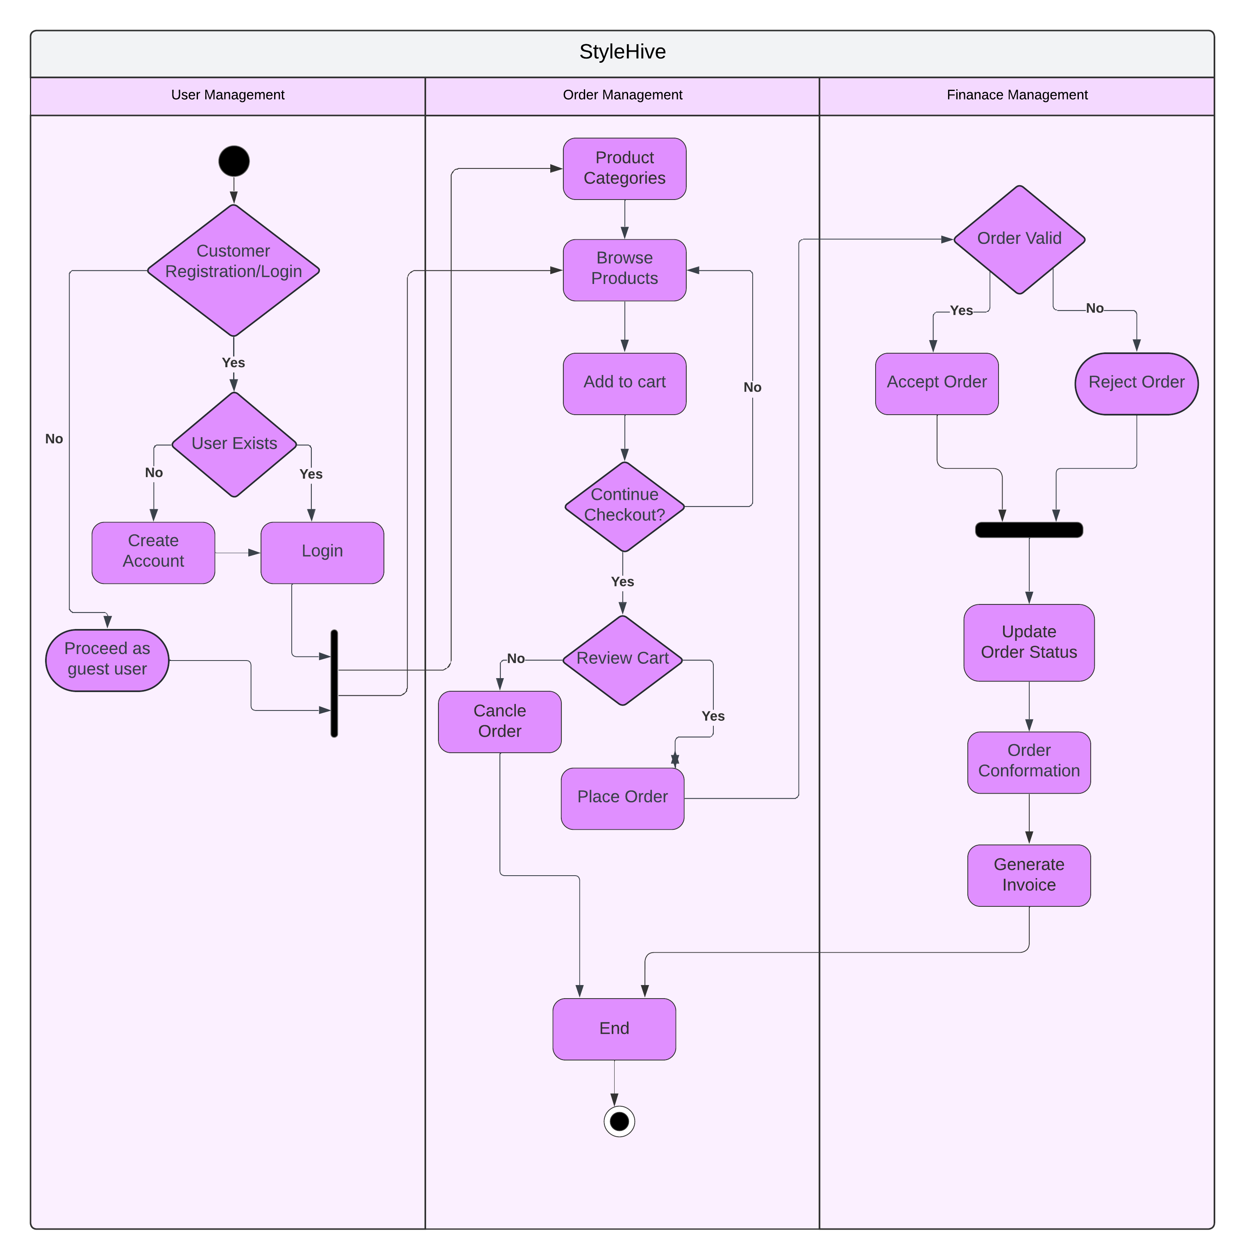
Activity Diagram- StyleHive

